Slide 1
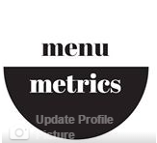
menumetrics
…Helping you decide what you want to eat!
Rozalya Everstova Michael Denis Joel Sands Natalie Lowell

Slide 2
What is it?
Look up quick food facts based on restaurants in your location
Compare nutrition of selected meals
Quick, easy way to decide what restaurant and meal you choose!

Slide 3
Mock Ups
Revised requirements and focus
Created larger, clearer paper pictures
Mobile prototype

Slide 4
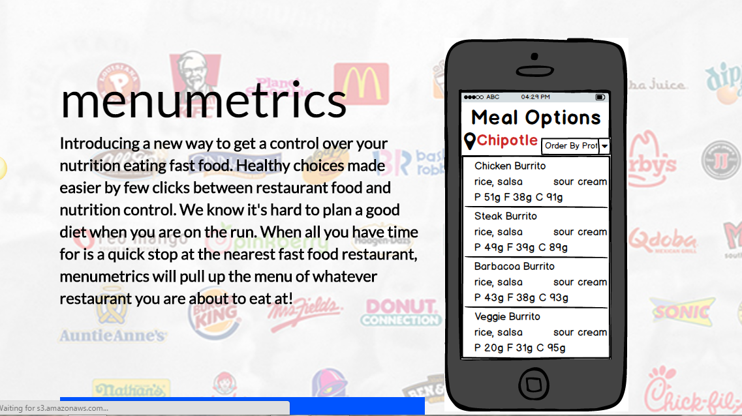
Webpage
Updated description to reflect new
features and highlights
Improved readability of text
Thoroughly tested site usability (links)

Slide 5
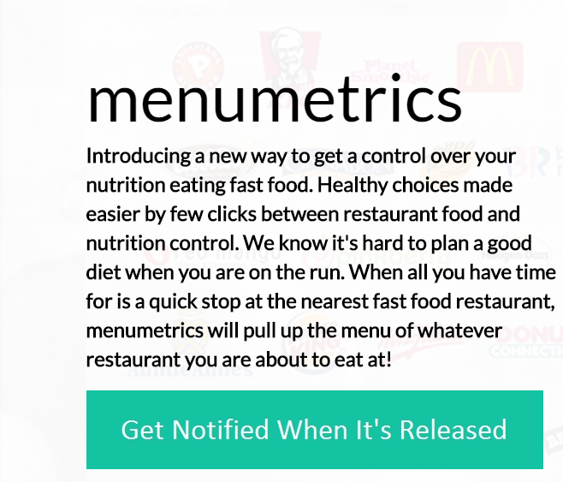

Improved website

Slide 6
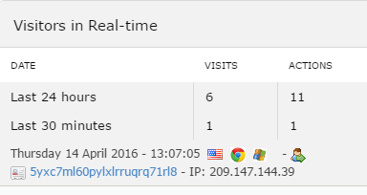
Results
2 new users
1 user shared using the links

Slide 7
Facebook
Deleted due to lack of value

Slide 8
Plan to improve
Get feedback using prototype around campus

